Slide 1
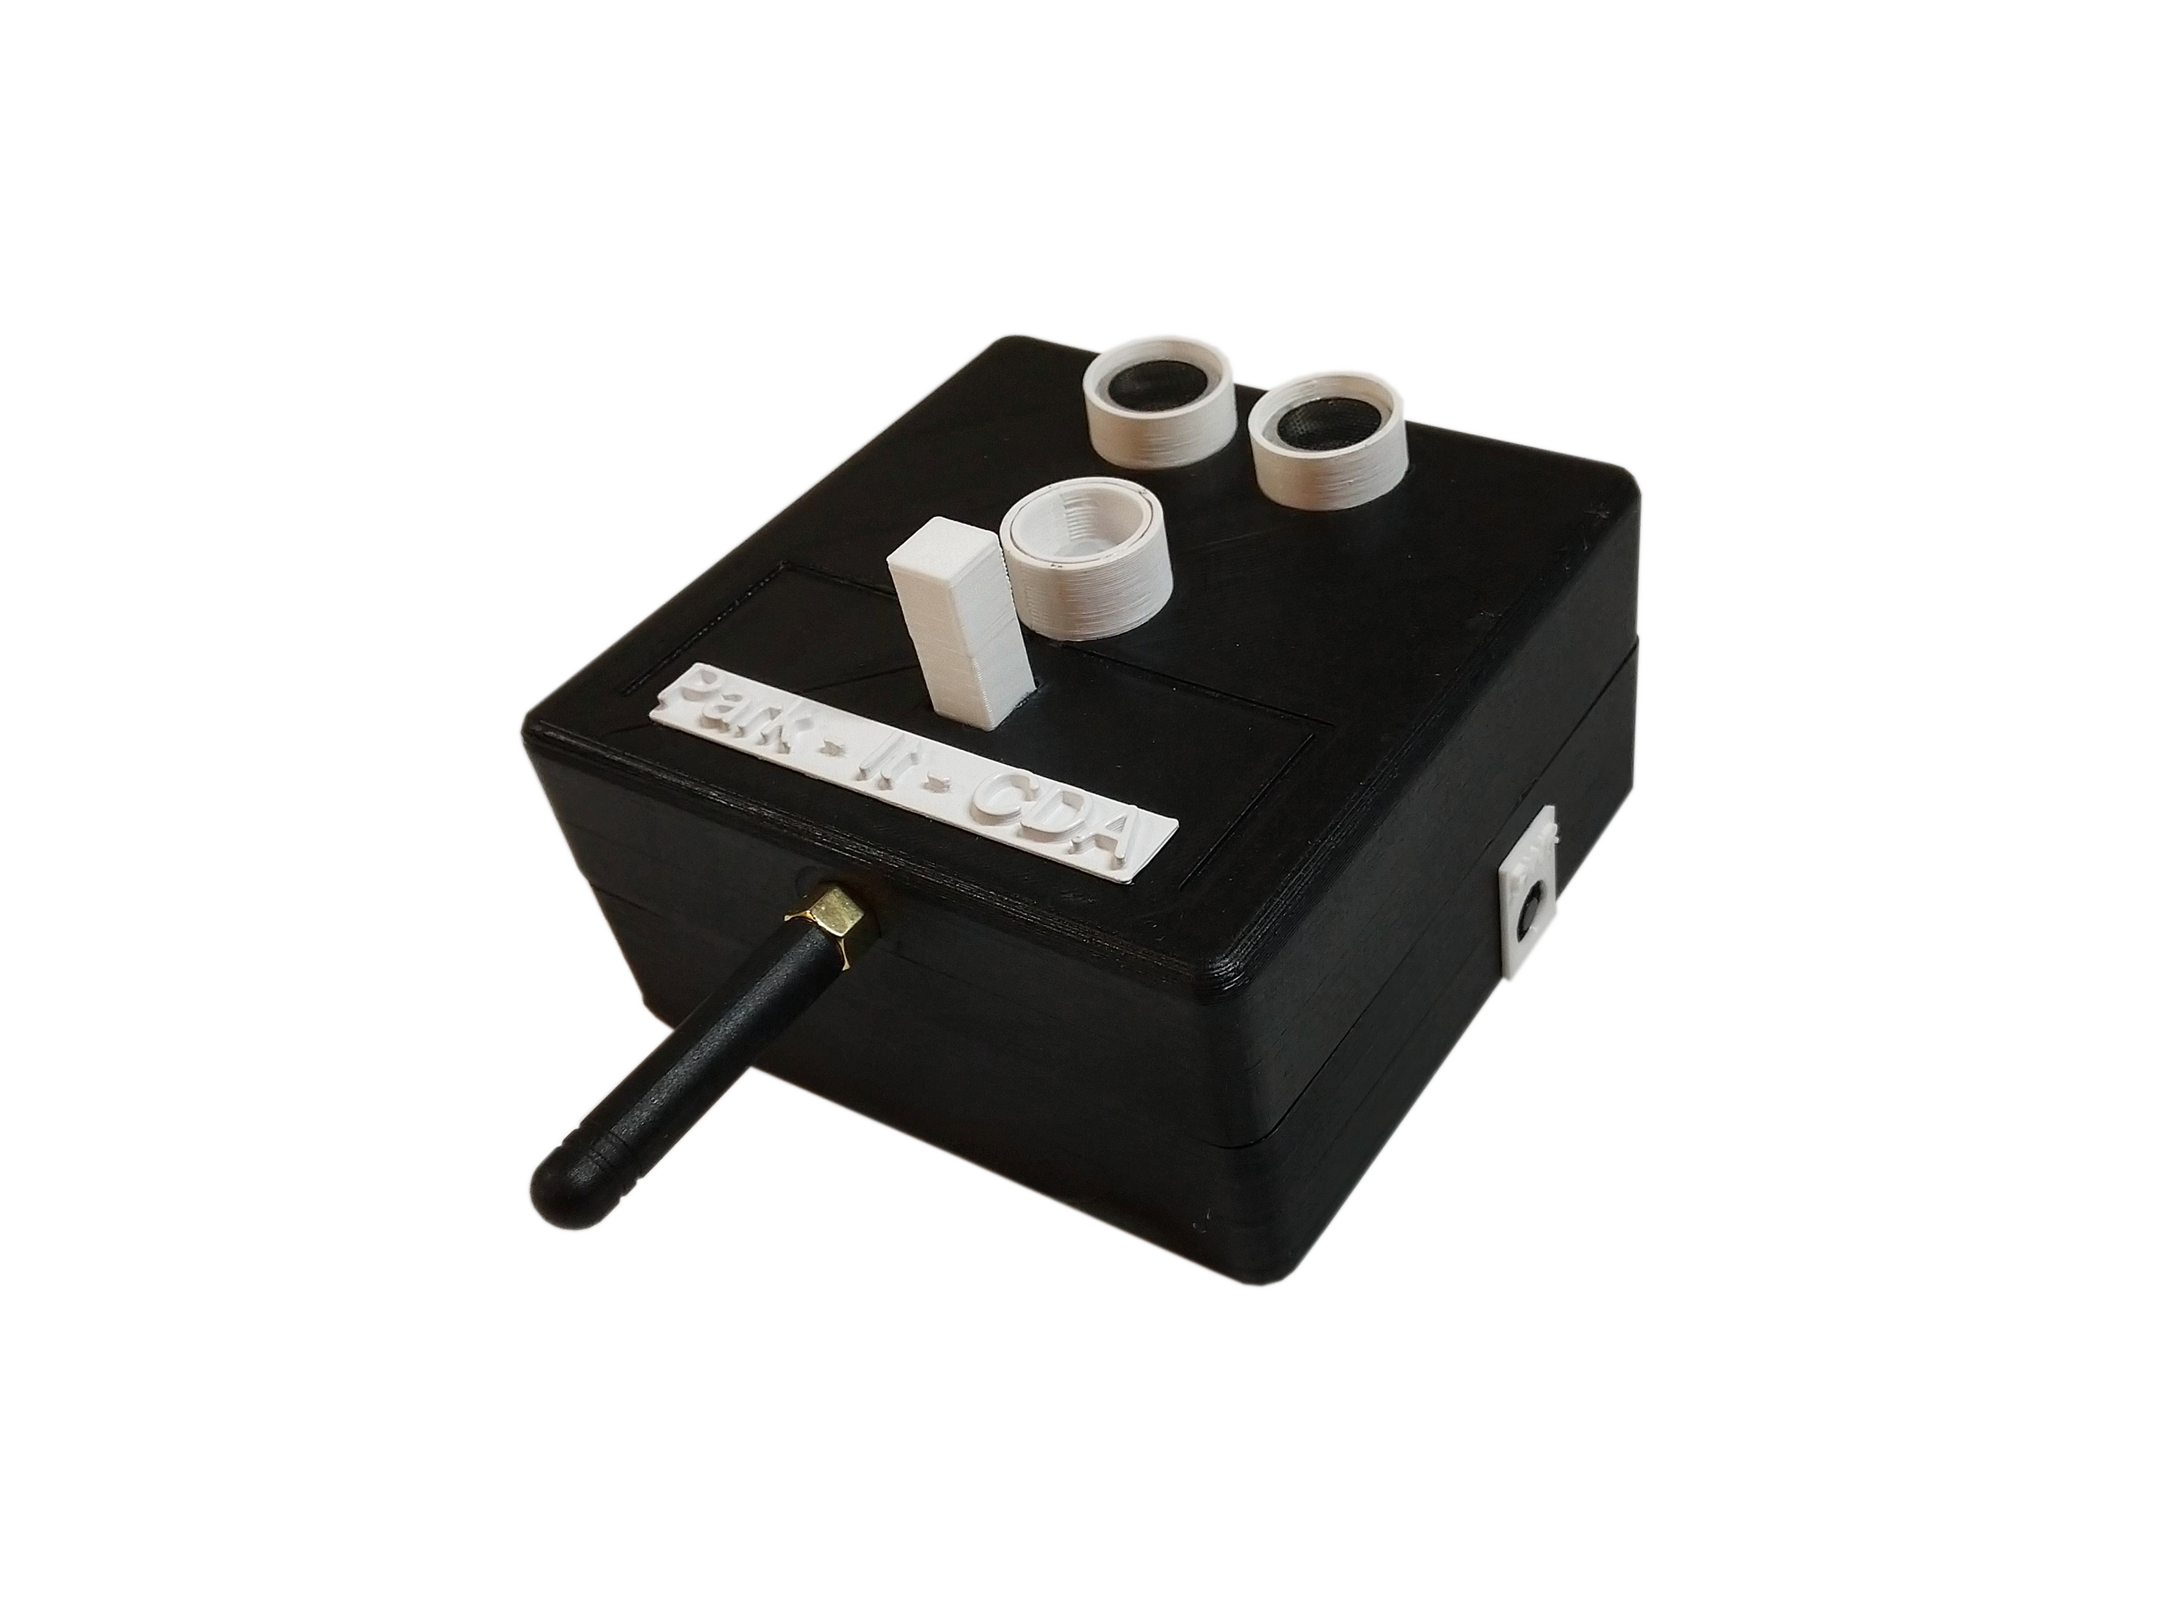
Park – It - Cda
A Garage sensor system over a mesh network

Slide 2

Park – it - cda
Team members and roles
Nikolai Tiong
Tyrel Parker
Team leader
Mesh network
Simulation
Database
Zane Goodrick
Joel Berain
Unit Design
Sensor Prototyping
Encryption
Wiki Site

Slide 3
Value proposition
The problem
Too much time and effort are being spent by those looking for a place to park in one or more garages in downtown Coeur d’ Alene.
Our solution
A parking indication system
Vehicle sensing over stalls
LED indication to commuters
Mesh networking via detection/indication units
A dynamic companion webpage to monitor/simulate entire garage

Slide 4
Objective and deliverables
Our goal
Outfit the parking garage in downtown CDA with 5 prototype units
Build a mesh network for units to relay stall status to a gateway at the Innovation Den
Build a simulation to show what a full-garage deployment would look like

Slide 5
Requirements
Optional features
The units | The mesh network | The simulation
 |  | Expandable for future projects
The units | The mesh network | The simulation
 | Units can choose a master and slave dynamically to save on battery | Graphical representation of system
lasts at least a year via battery power | Encryption of data | Companion app for phone/tablet
Security camera-like appearance for theft/tamper prevention |  | Data collection
Enclosure no larger than 4” X 4” X 4”
Units relay messages to gateway at the den
representation of a full garage deployment
Redundancies of sensors for better accuracy
Sensors to detect presence of vehicles in stall
Data maintains integrity and authentication
Real time updates of stall status
LED to indicate stall status to commuters
Units are provisioned
Populated with accurate test data
Units synchronized and can communicate for message routing
Notes:
<number>

Slide 6
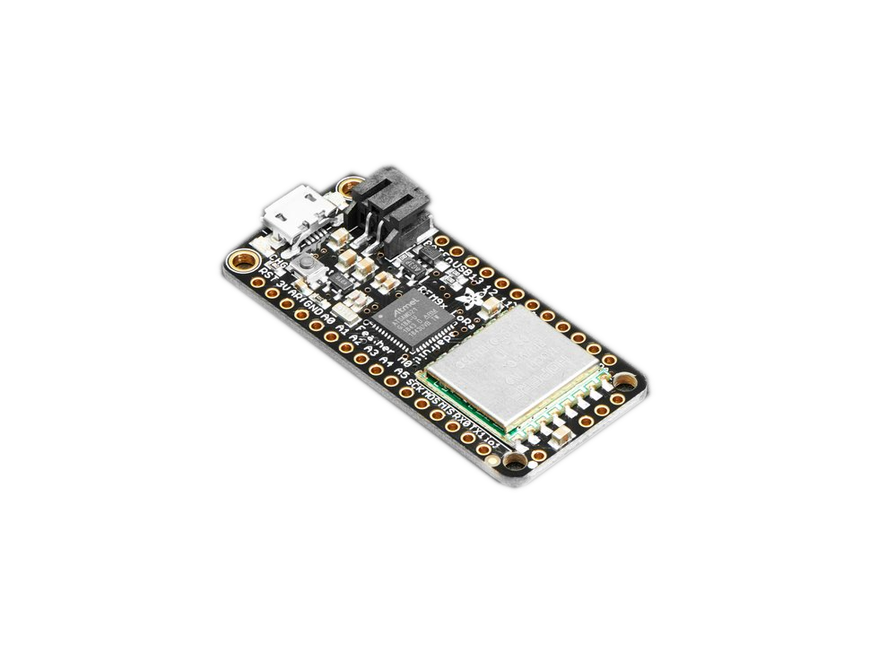
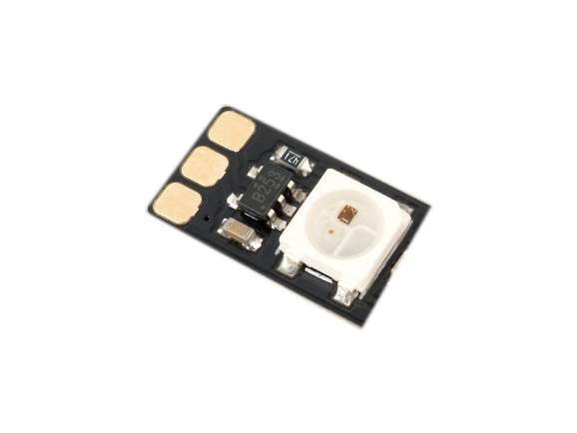
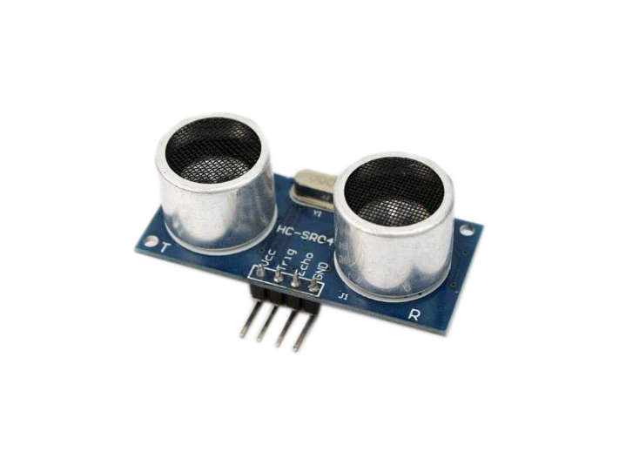
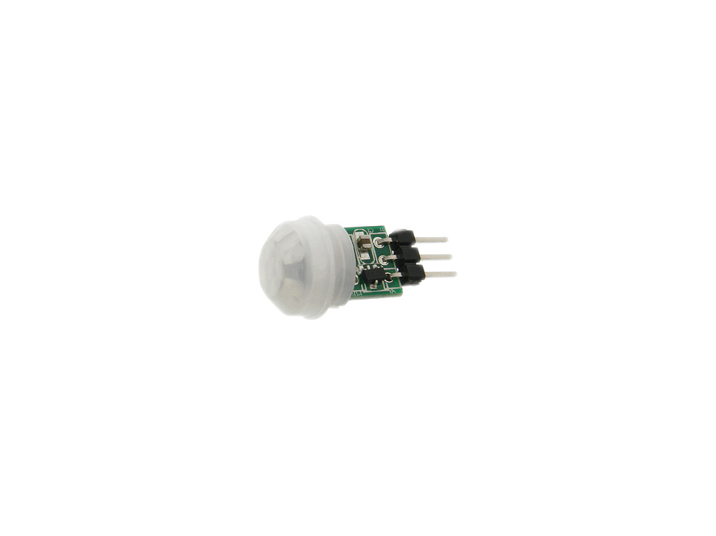
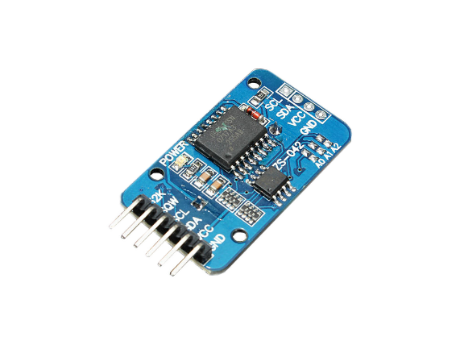
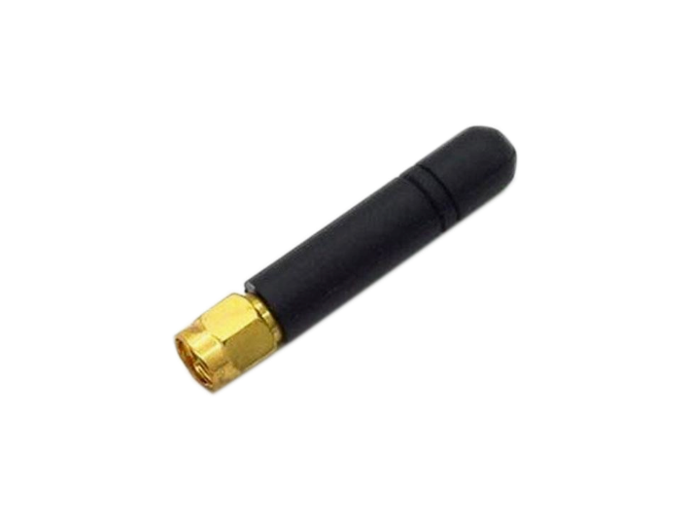
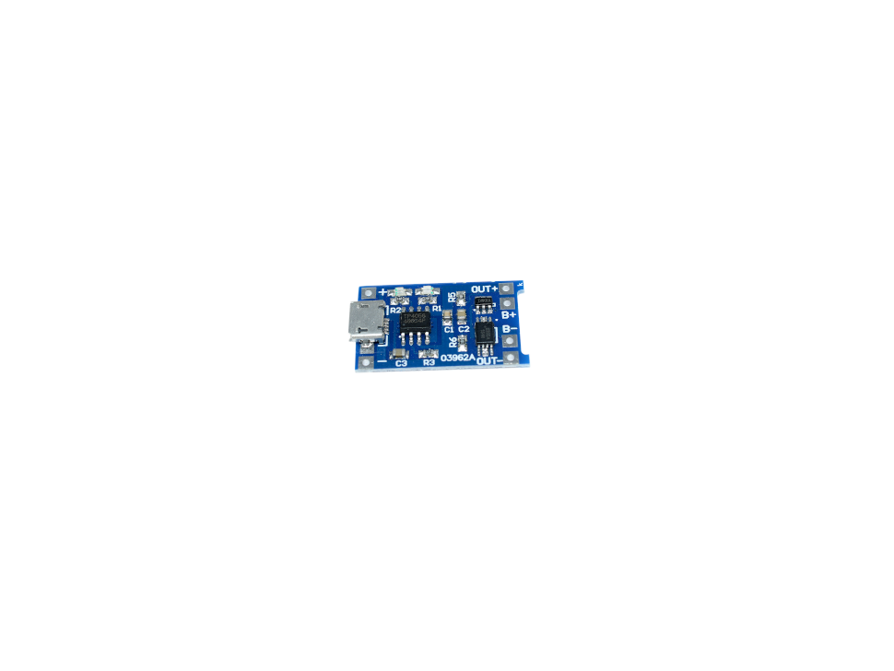
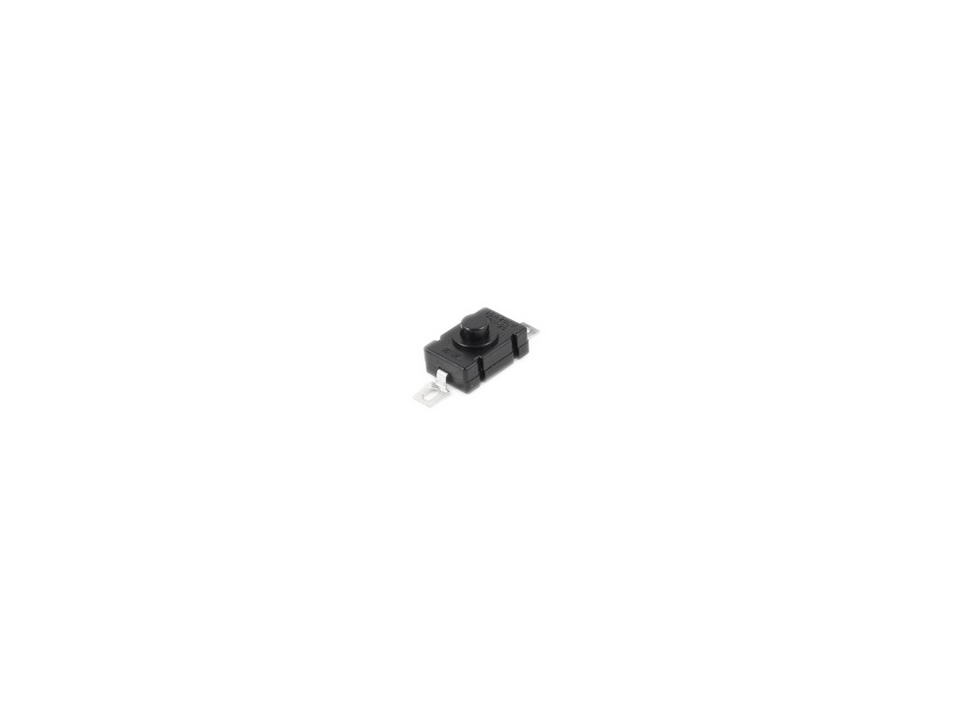
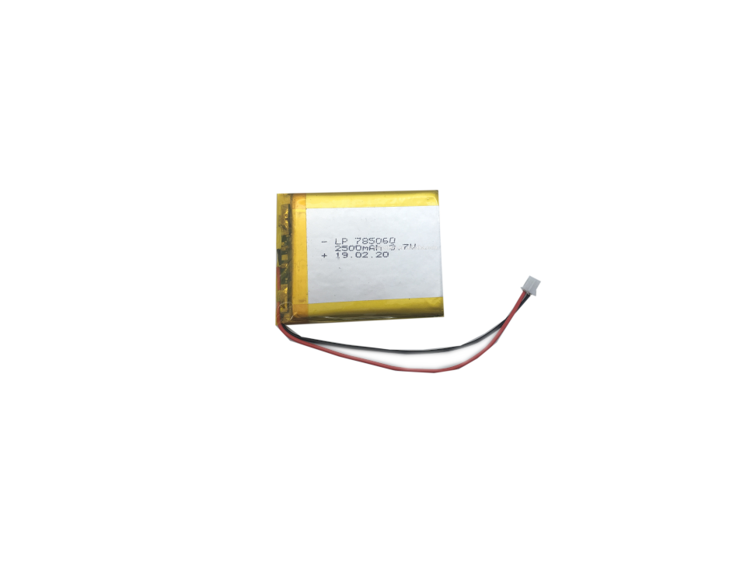
Components
The hardware
The Sensors
The Microcontroller
Other Components
Adafruit Feather M0 LoRa
RGB LED
HC-SR04 Ultrasonic Sensor
Real-Time Clock
AM312 PIR Sensor
LoRa Antenna
Power
2500mah Lipo Battery
Lipo Charger
Latching Power Switch

Slide 7
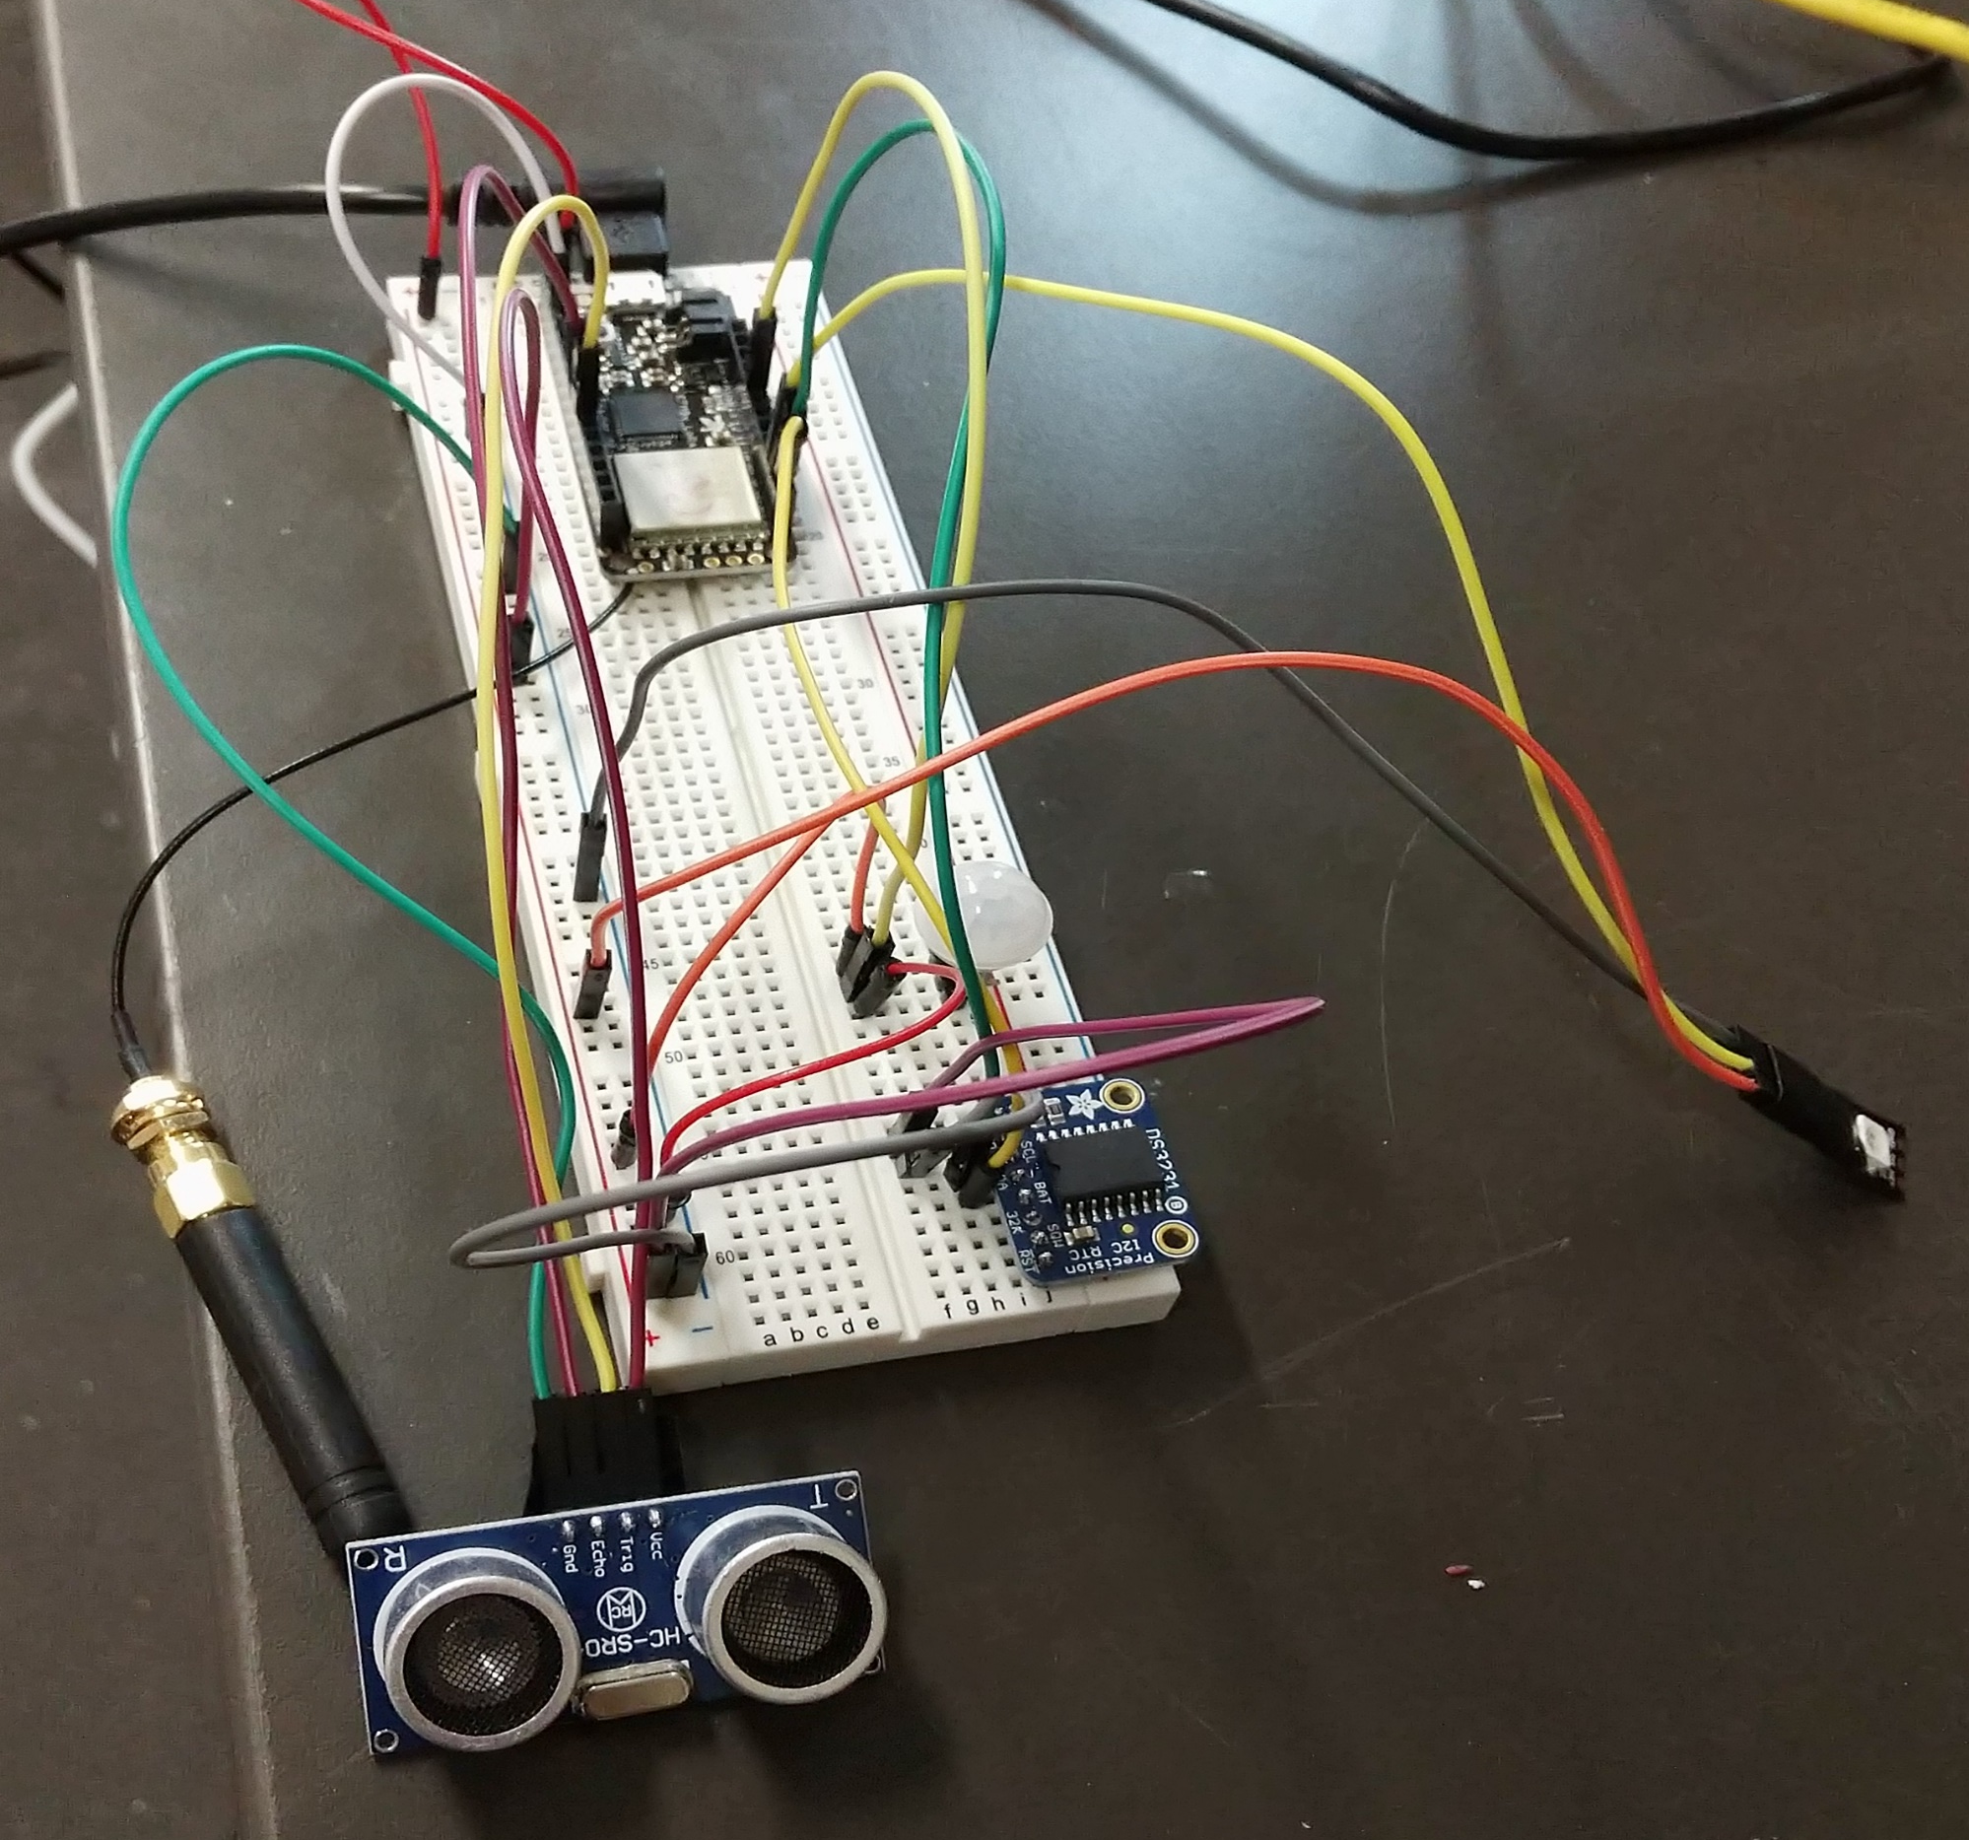
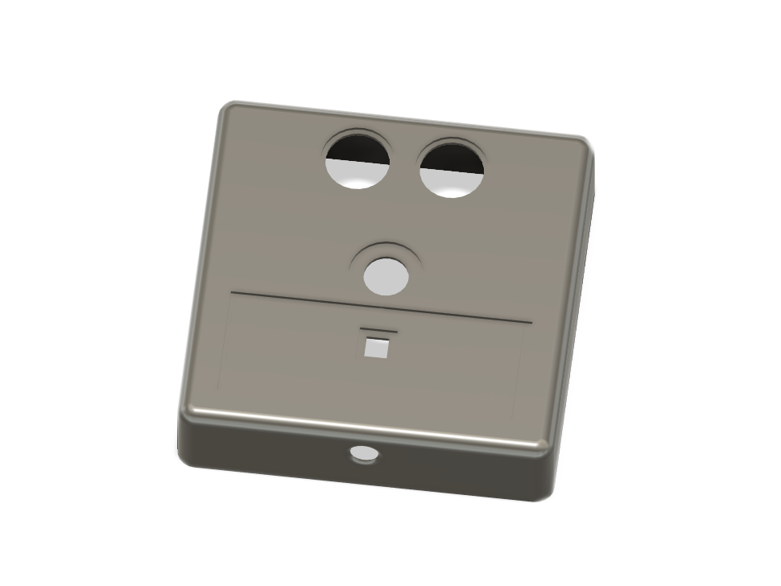
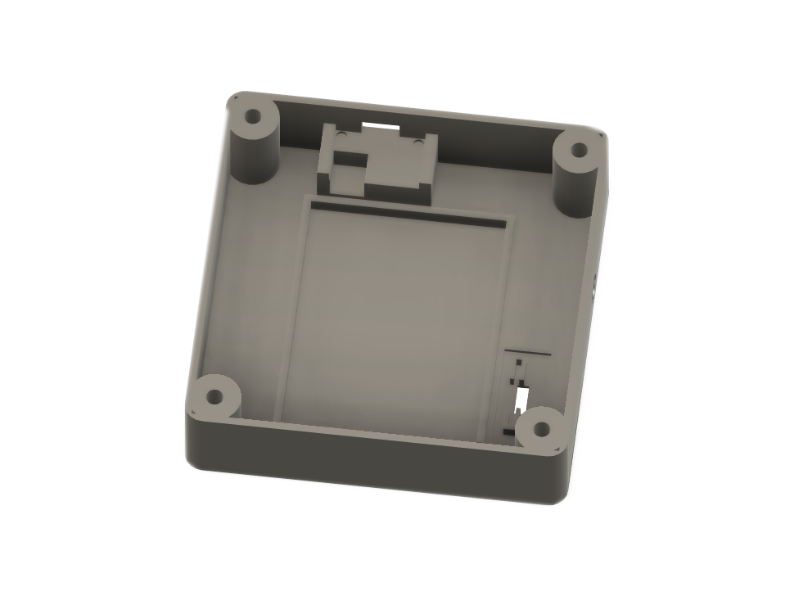
The Enclosure
Prototyping, Designing and assembling
Feather M0 w/LoRa
Designing the enclosure
PIR sensor
RGB LED
Real-time clock
LoRa antenna
Ultrasonic distance sensor
Final enclosure design created in Fusion360
Breadboard assembly

Slide 8
Completed prototype
- The ultrasonic sensor reads the distance to the ground 3 times to see if there is a blockage in the stall, outlying distances are thrown out in a 2 – to – 1 vote
- The PIR motion sensor wakes up the CPU via external interrupt when a heat signature (vehicle) is detected below
- The processor changes the LED from green (vacant) to red (full)
- Stall status is sent periodically to the gateway over LoRa transmission
- Additional design features include a power switch
- And access to the processor and battery underneath for charging and updating

Slide 9
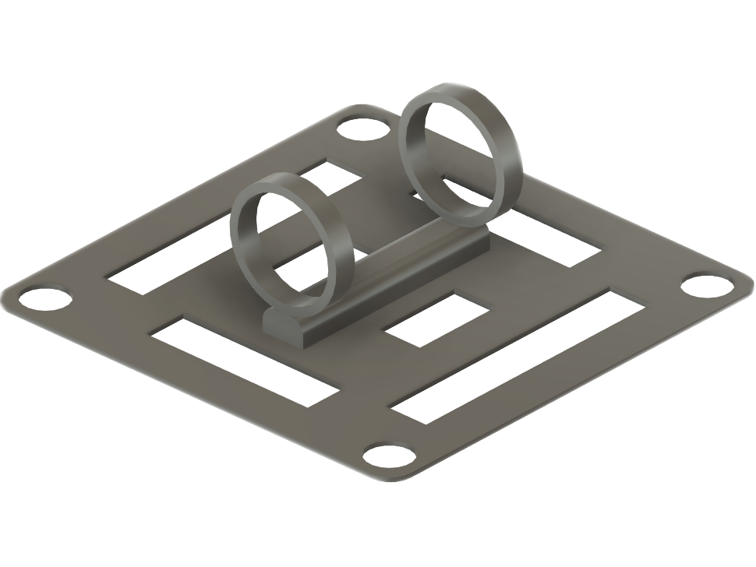
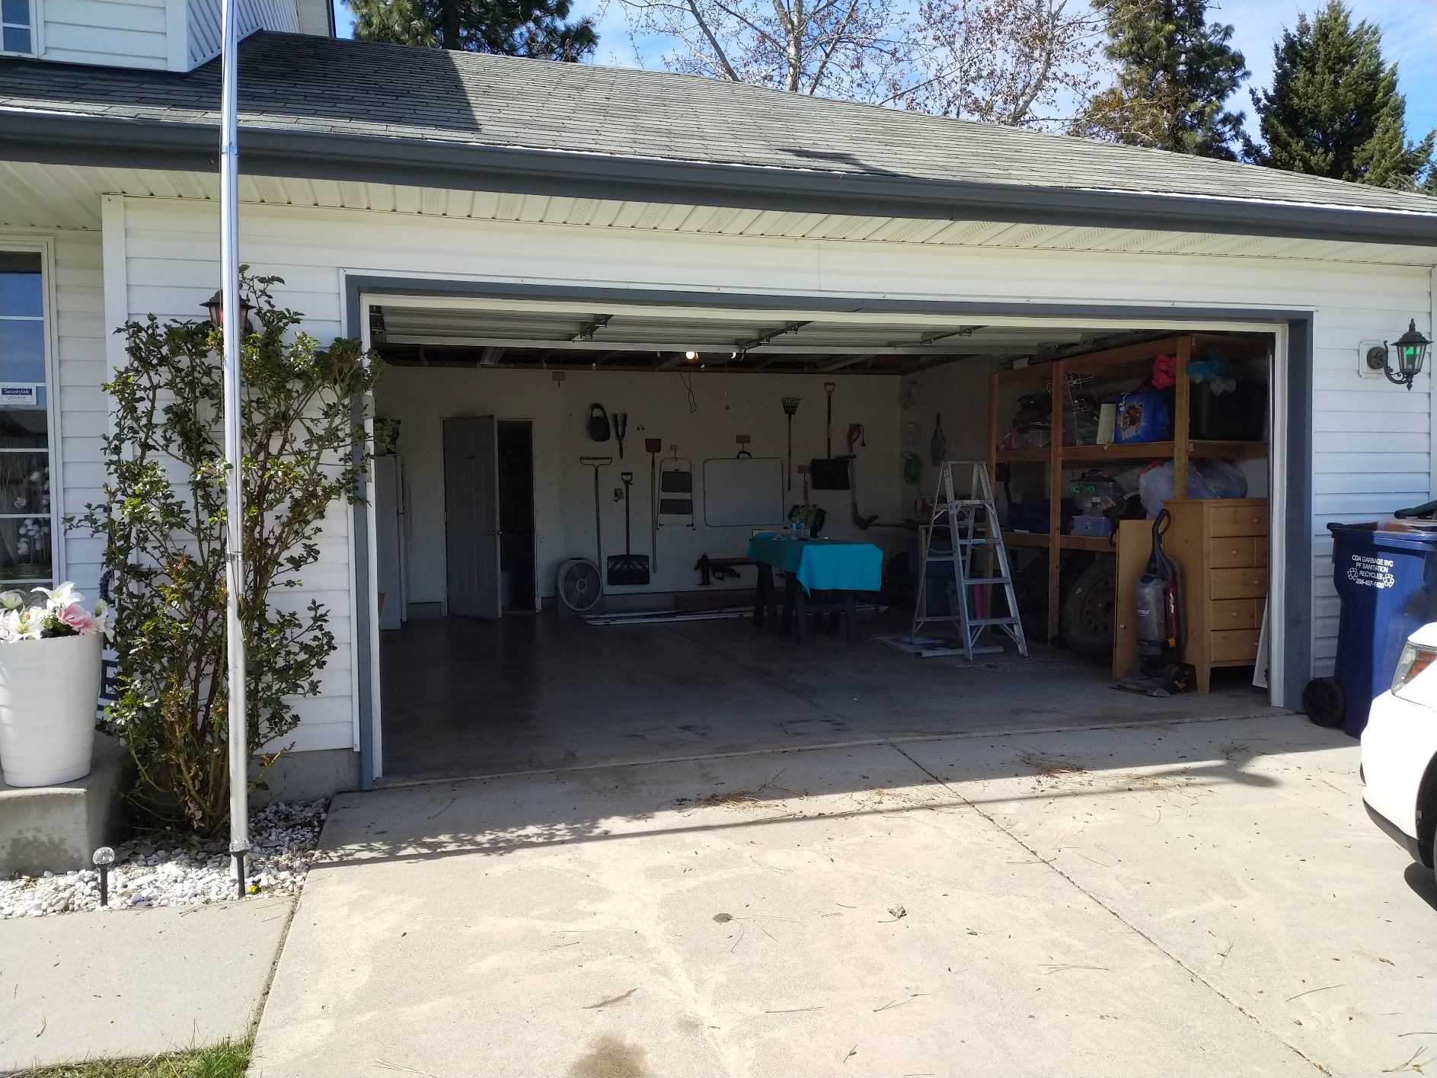
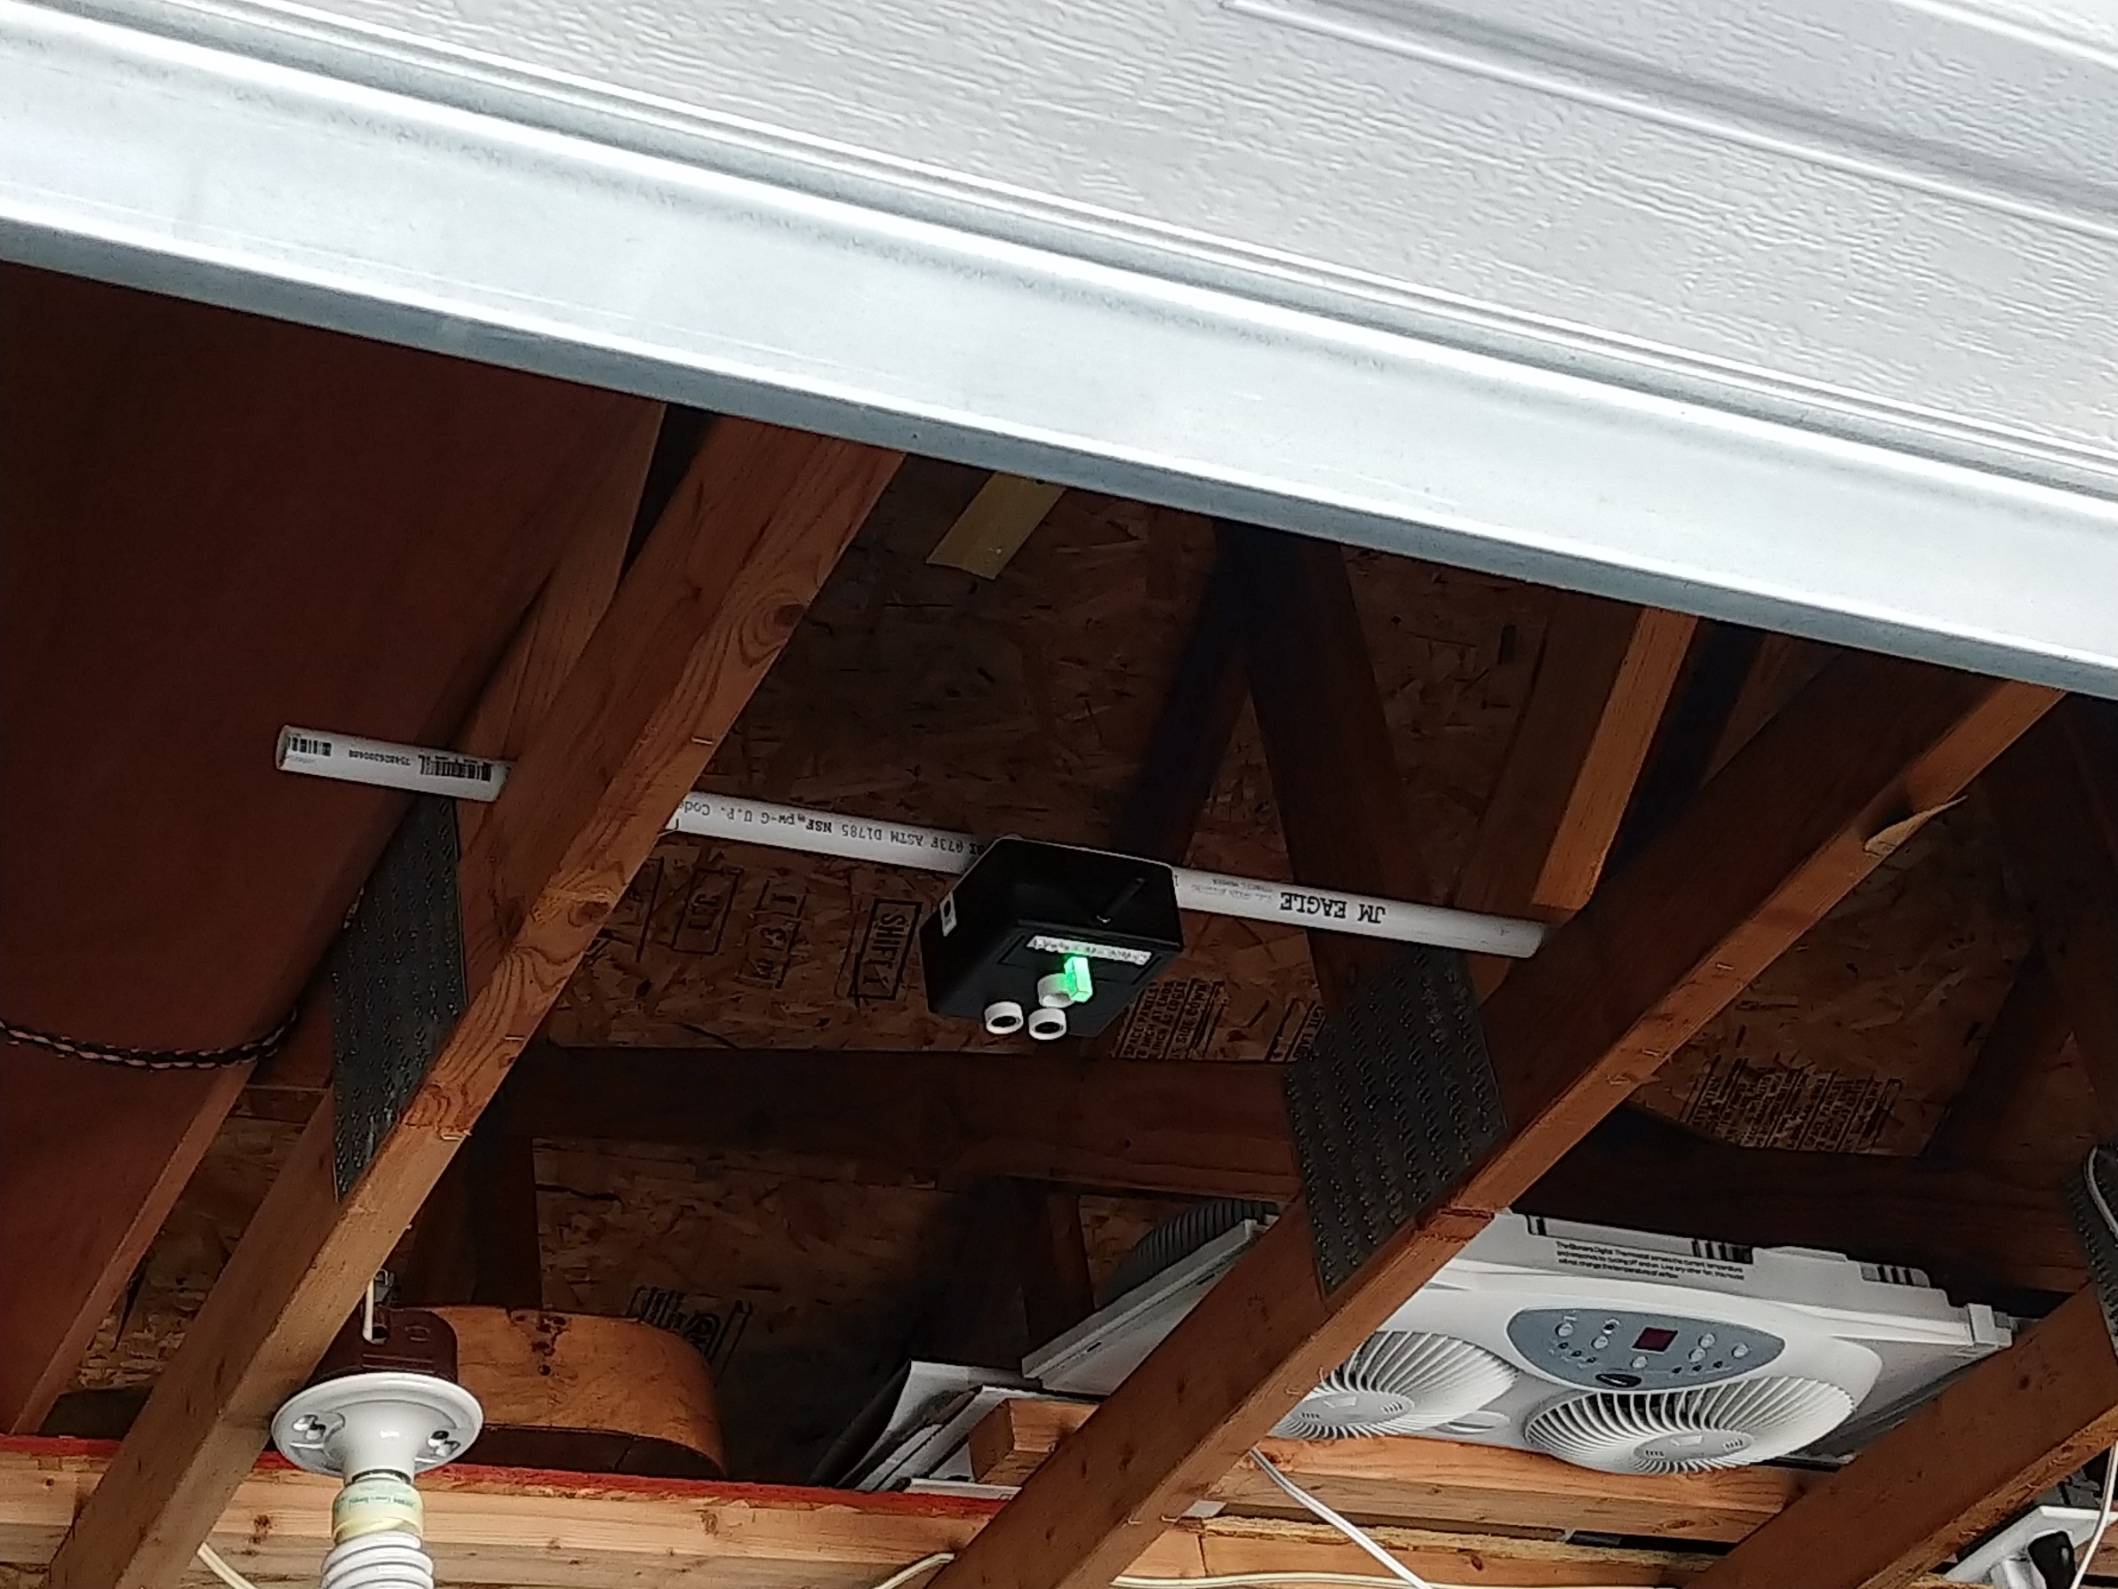
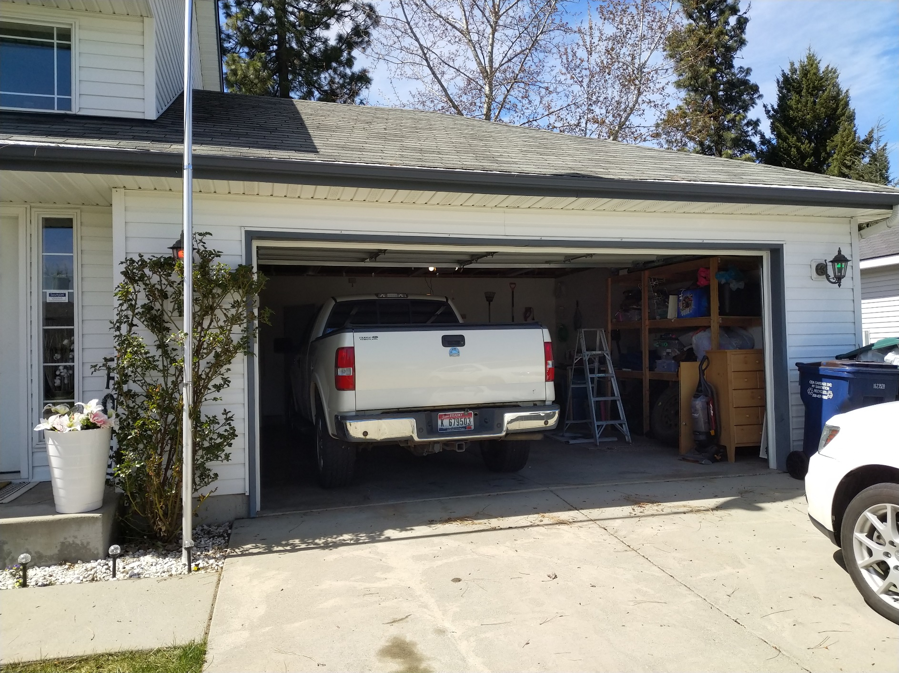
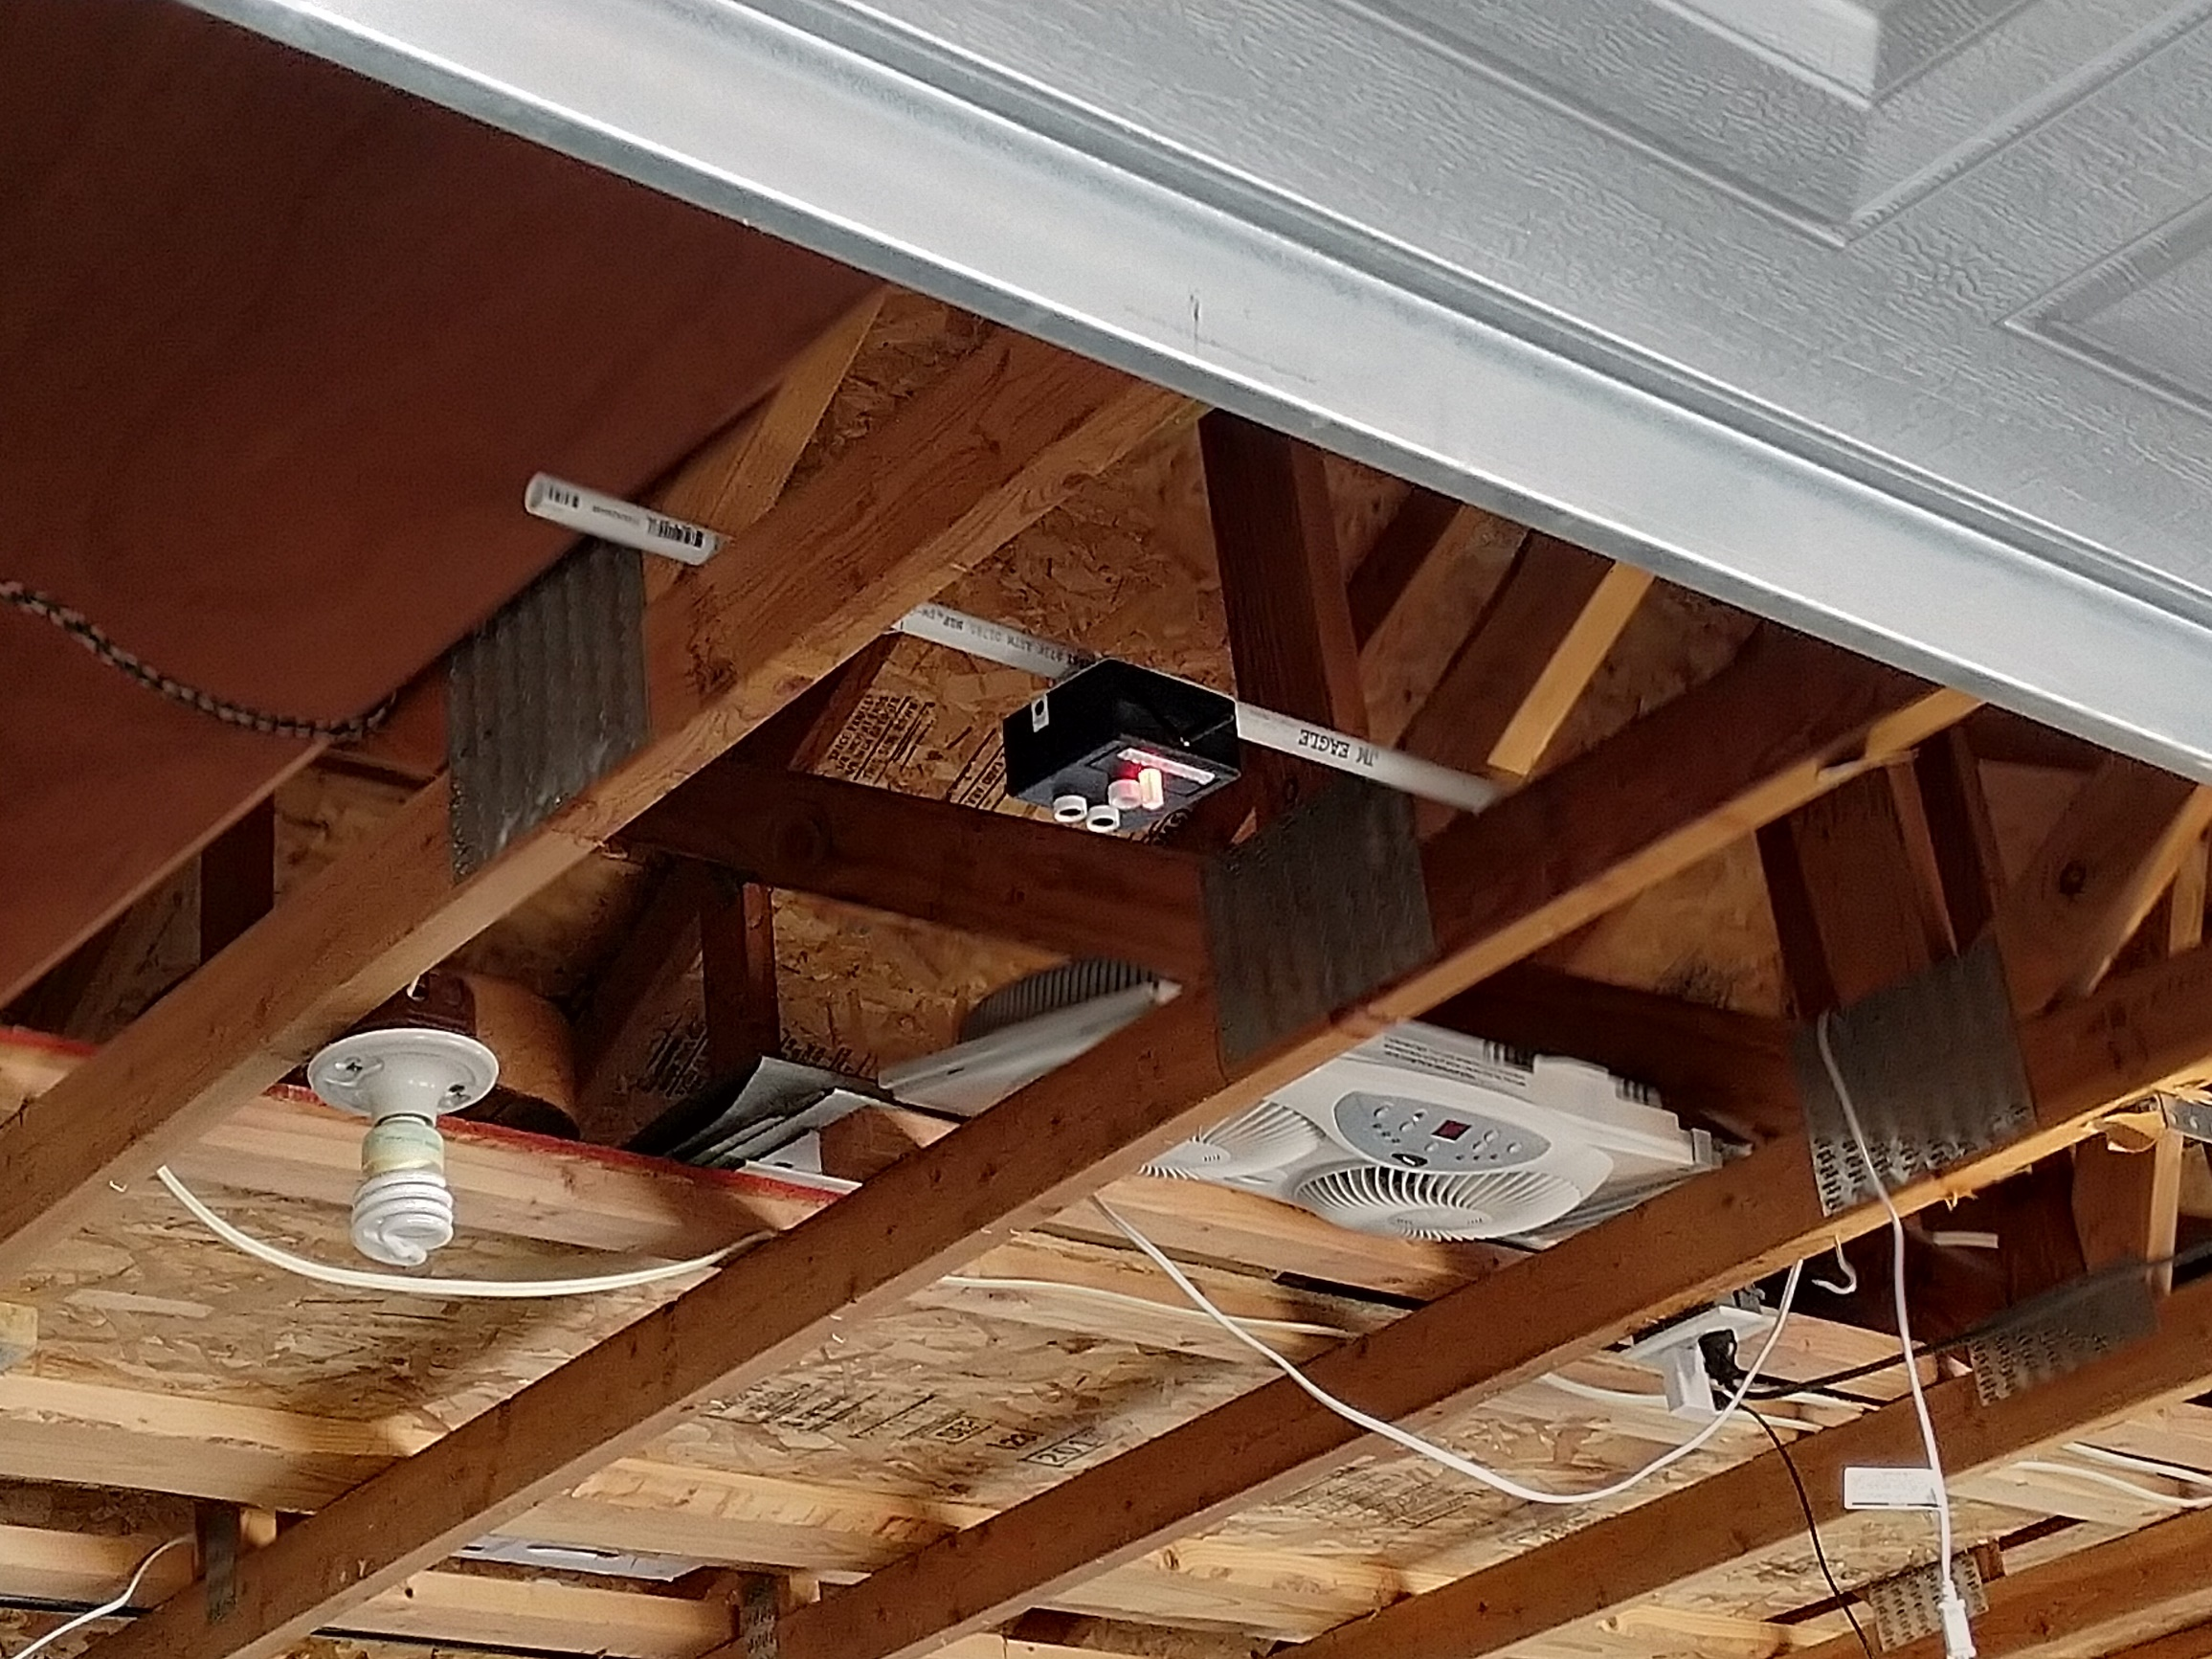
Sensing vehicles
Stay at home testing
- 3D printed PVC mount

Slide 10
Nikolai mesh networking
LoRa
LoRa (Longe Range) was selected due to its ability to transmit over a long-range -10’s of Kilometers in perfect conditions, and low power usage in sleep mode
Originally going to create a mesh network where each of the 5 Garage Sensor Units (GSU) can communicate with one another
The GSUs would determine amongst themselves one of them to become the Garage Sensor Master (GSM)
The GSM would receive messages from the GSUs and then send data over to the Innovation Den
Due to time limitations, the network was changed to become a star with a fixed GSM
Our testing revealed that we will be able to make the distance between the parking garage and the Innovation Den approx. 350 ft apart.

Slide 11
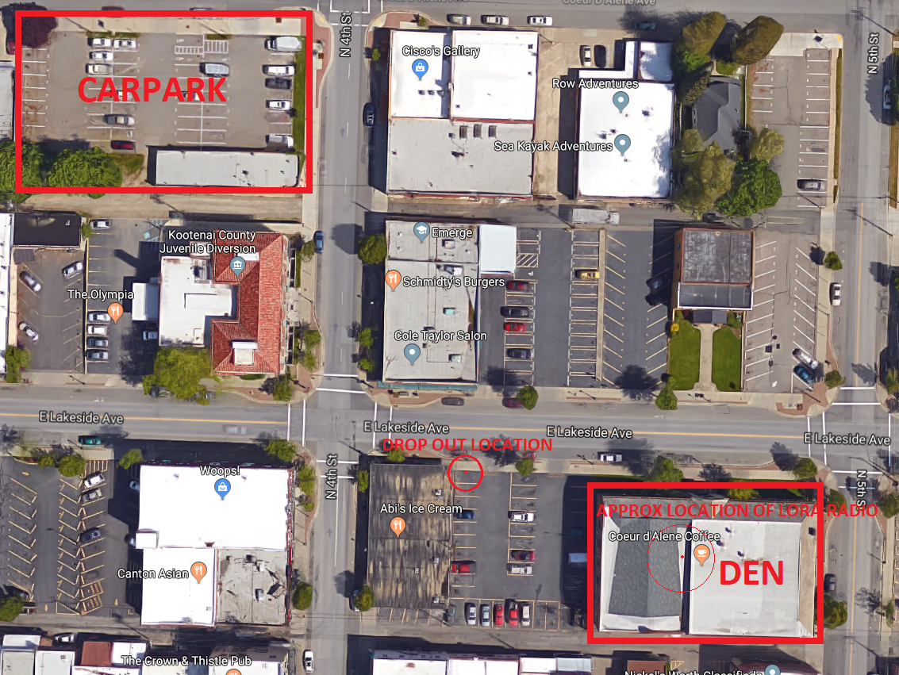
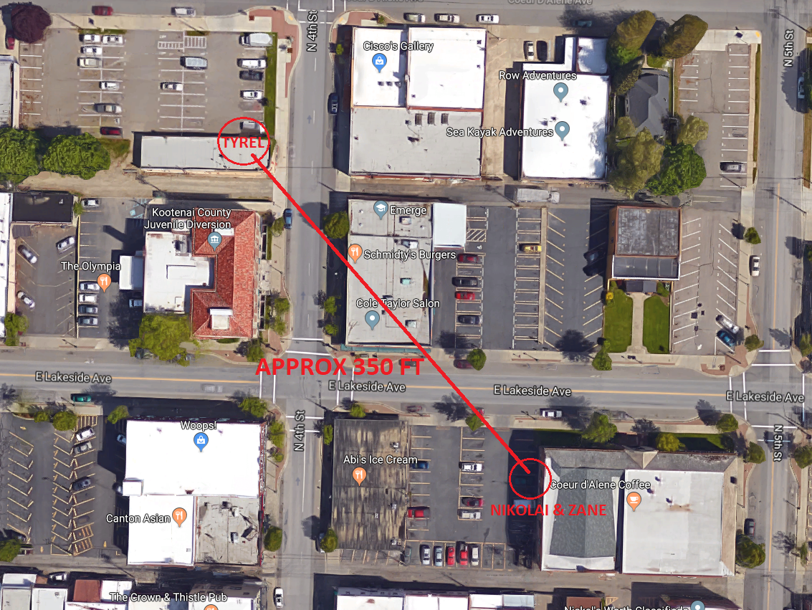
Nikolai mesh networking
LoRa
Our testing revealed that we will be able to make the distance between the parking garage and the roof of the Innovation Den approx. 350 ft apart.

Slide 12
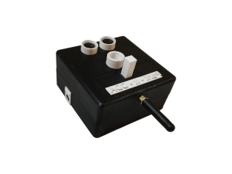
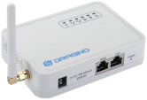
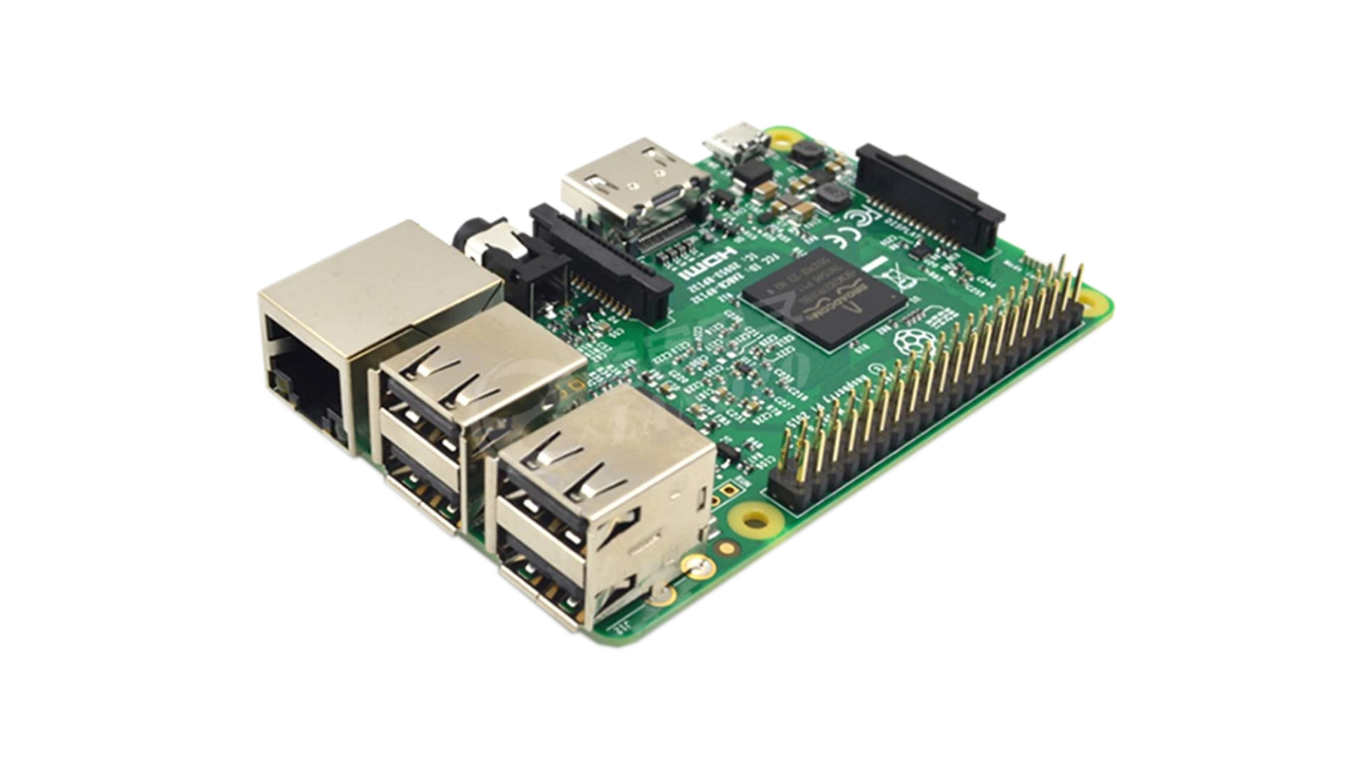
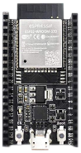
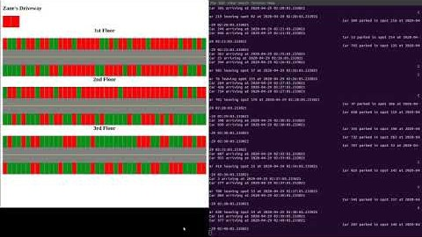


Gateway
Data Server
Units
Simulation Code Running
Web Server
Display of Parking Spots in HTML
User Devices

Slide 13
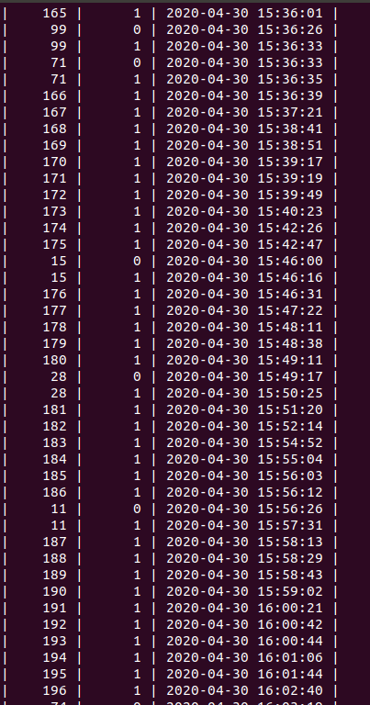
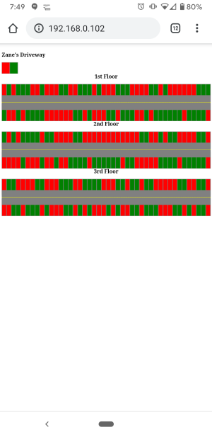
Tyrel Simulation

Slide 14
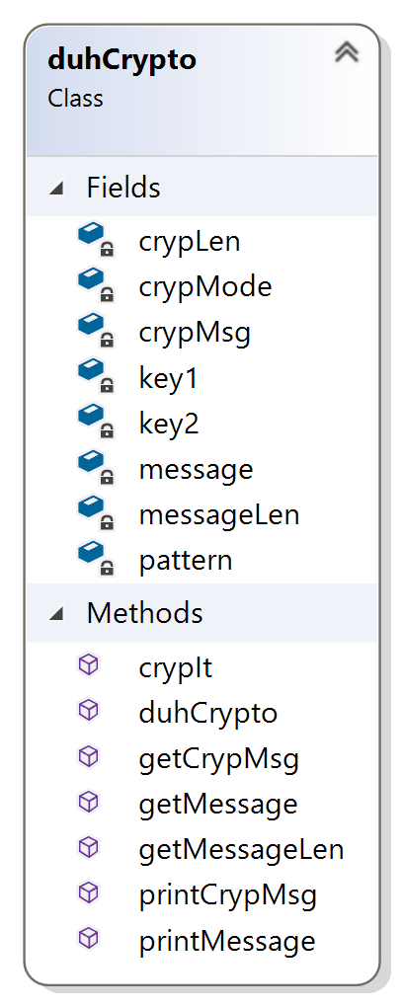



Joel Encryption
Encryption
A class was created to send and receive crypted data throughout the network. This
class implements private key cryptography.
Two private keys and a predetermined pattern are used to encrypt and decrypt data
Encryption method
Methods to access or print the original and crypted data

Slide 15
Joel Encryption
Font 48 for headlines
WIKI
Font 36 for lists and other txt

Slide 16
Covid-19 update
Our efforts to test and communicate while staying at home
Being a collaborative group, with each portion of our project communicating together dynamically, the “stay at home” order greatly affected our project
We could no longer be in the same location
The garage we planned to deploy our prototypes in was unavailable
We needed a way to communicate and test our units while remaining at home

Slide 17
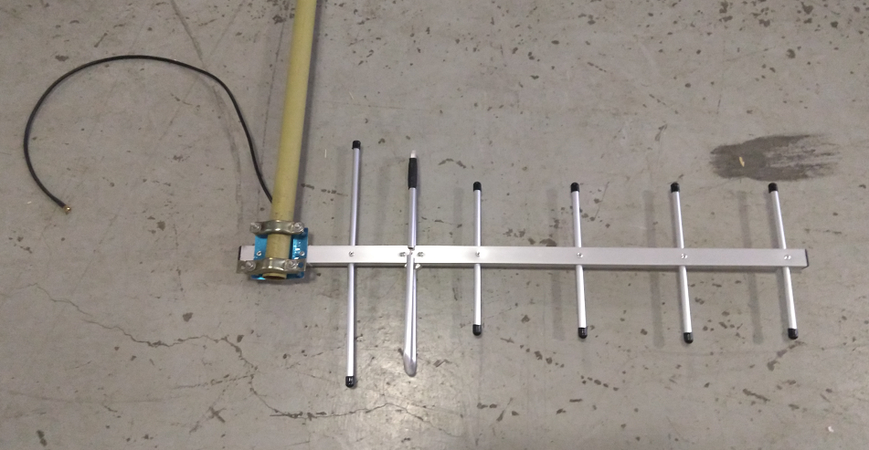
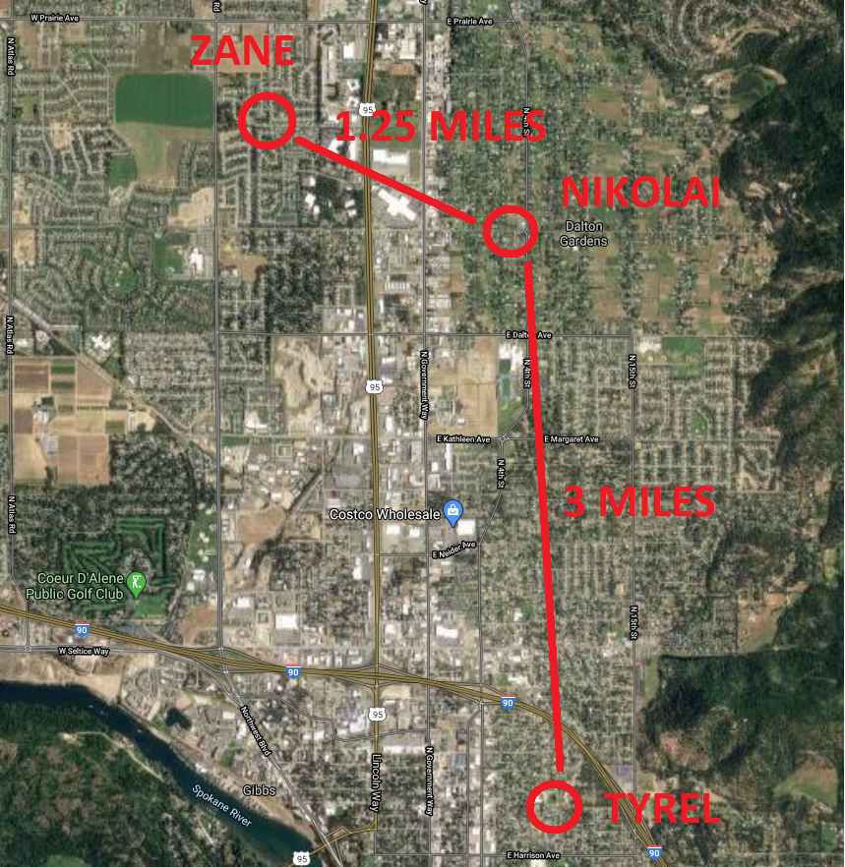
Lora stands for long range
Testing the capabilities of our transceiving medium
Dr. Shovic gave us 2 Yagi antennas used for extremely long range transmissions
The specs for the antenna are measured in line-of-sight conditions
We were hopeful that a house-to-house communication would be possible
Zane and Nikolai were the closest in proximity, being just over 1.2 miles apart
Nikolai uploaded some simple transceiver tests to the LoRa boards

Slide 18
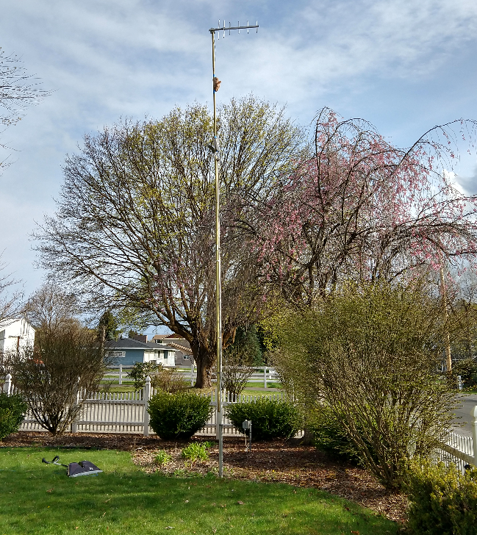
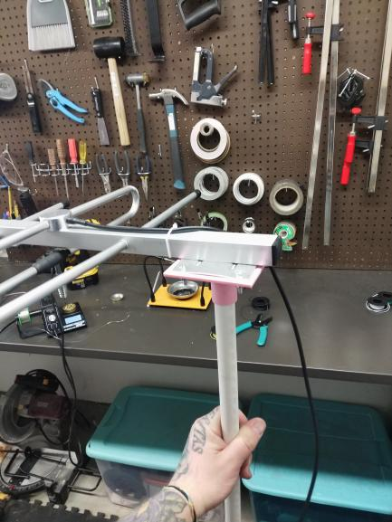

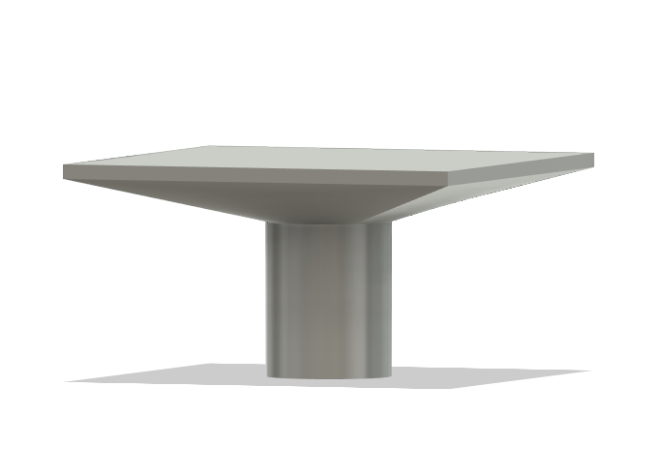
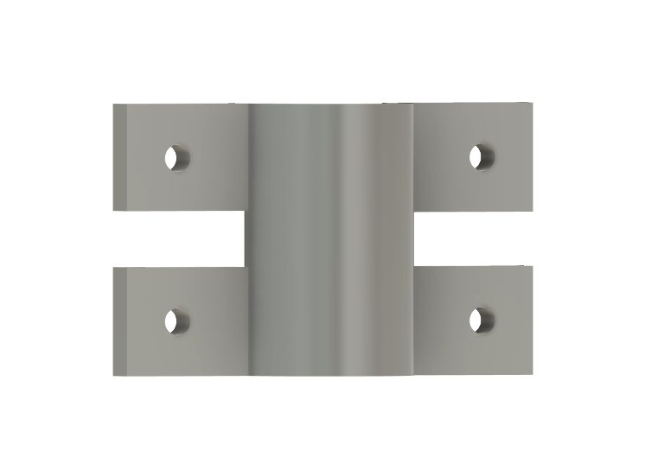
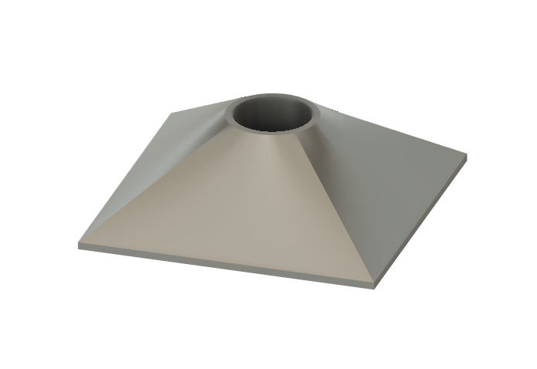
Testing long range
Makeshift masts and 3d printed hardware
Nikolai acquired a 20’ TV antenna, and turned it into a mast, attaching it to his flagpole
Zane designed some custom hardware for affixing a mast made from PVC to his roof

Slide 19
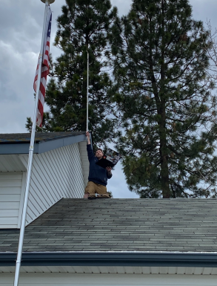
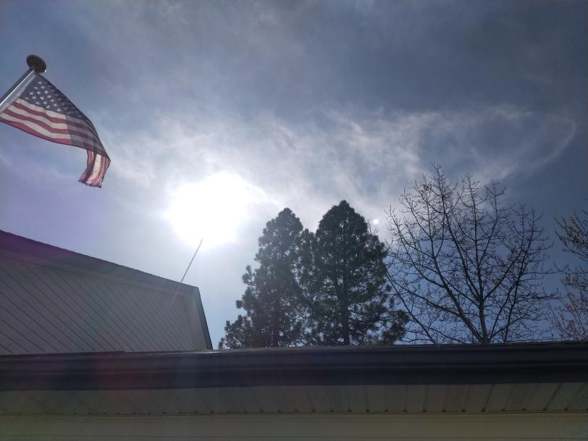
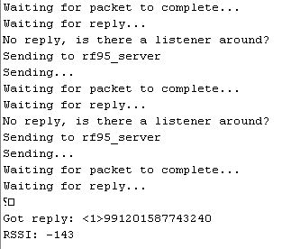
Successful transmissions
There were several successful transmissions made and received between both Zane and Nikolai
However, many more packets were lost than were received

Slide 20
Final setup
Something more reliable
In the end, the long-range communication just wasn’t stable and reliable enough for demonstration purposes
Our final setup for testing involves having the units, and the gateway at the same location
However, our testing has shown us that the units will be more than capable of transmitting messages from the parking the garage to the Innovation den once both have reopened and the project is able to be properly deployed

Slide 21
Park – it - cda
Questions
Nikolai Tiong
Tyrel Parker
Team leader
Mesh network
Simulation
Database
Zane Goodrick
Joel Berain
Unit Design
Sensor Prototyping
Encryption
Wiki Site

